Slide 1
ESTATE PLANNING FOR PETS

Slide 2
ABOUT PERPETUAL CARE, INC
A 501(c)(3) Nonprofit Organization since October 2, 2002
Better Life Choices for Orphaned Pets
Mission: Perpetual Care educates the public and helps pet owners regarding estate planning for their pets, and Perpetual Care rescues and finds homes for pets orphaned by death or disability of their guardian, or provides them a home at our Pet Life Care Center.
Notes:
Comment that while we take care to adhere to the applicable laws, our mission is about animal welfare

Slide 3
ABOUT PERPETUAL CARE, INC
Vision Statement
Our vision is for a time that family pets will no longer go into shelters or be killed because their guardian cannot care for them due to disability or death. To that end, it is also our vision that there will be Perpetual Care Life Care Services and Centers everywhere across the country to help orphaned pets find a loving home rather than going into a shelter.
Notes:
2/3rds of Americans do not have a living will. 60% do not have a will in place

Slide 4
Animals-A legal issue
Legal Status of Animals as Property
Animals as Sentient Beings-
The ability to feel things such as joy, pain, fear and stress, etc. has huge implications for animal welfare and the current shelter system.
Reclassification of Animals to Non-Human Animals
Notes:
Our relationship with animals has changed over time and has become complex

Slide 5
Animals-A political issue
The Animal Welfare Act (P.L. 89-544)signed into law by President Lyndon B. Johnson on August 24, 1966. It is the only Federal law in the United States that regulates the treatment of animals in research and exhibition.
Animal Welfare-deals with the treatment of an animal; providing for its physical and mental needs.
These include the need:
for a suitable environment (place to live)
for a suitable diet.
to be housed with or apart from other animals (if applicable)
to be protected from pain, suffering, injury and disease and,
to exhibit normal behavior patterns.
Animal rights - Non-Human Animals are entitled to the possession of their own lives and that their most basic interests—such as the need to avoid suffering—should be afforded the same consideration as similar interests of human beings.
Notes:
2/3rds of Americans do not have a living will. 60% do not have a will in place

Slide 6
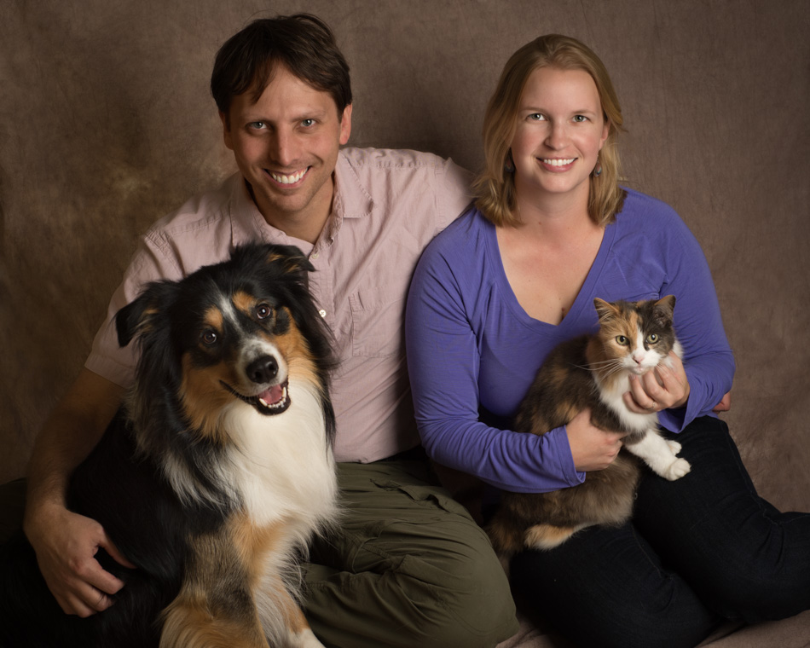
ANIMALS-AN EMOTIONAL ISSUE
FAMILY MEMBERS

Slide 7
U.S. SHELTER SYSTEM HISTORY
Pounds-Animal shelters evolved from pounds, which were used in colonial towns to round up and hold wandering livestock that could be redeemed from the poundmaster for a fee. Because an economic value was placed on these animals, they were often reclaimed. When the system began to be used to impound wandering dogs and cats, these animals were often killed because little monetary value was placed on them.

Slide 8
U.S. SHELTER SYSTEM HISTORY
ASPCA-The American Society for the Prevention of Cruelty to Animals (ASPCA) was founded in 1866 as the first animal welfare organization in the United States. The organization's focus was on the mistreatment of horses, not dogs and cats. Several other humane organizations were founded soon after in major cities, but they were not, and still are not, affiliated with each other.

Slide 9
U.S. SHELTER SYSTEM HISTORY
Animal Control-The concept of animal control and shelters slowly took hold, and cities began issuing dog licenses as a source of funding for these programs. However, the shelter's primary role was not to provide humane care and treatment of the animals but to provide public safety and to protect private property rights.

Slide 10
U.S. SHELTER SYSTEM HISTORY
Humane Shelters-In 1874, the Women's Branch of the Pennsylvania SPCA in Philadelphia became the first organization to focus on the humane treatment of shelter animals.

Slide 11
U.S. SHELTER SYSTEM HISTORY
Animal Control/Municipal
Nonprofit (Private) Shelters
Sanctuaries
Rescue Groups
Focus-Saving Lives & Population Management
High Volume Spay/Neuter
High Volume Adoptions

Slide 12
U.S. SHELTER SYSTEM STRUCTURE
(USDA) & (APHIS) Oversight
Municipalities –required to have a system of dealing with stray animals-Animal Control
Municipal shelters are open admission, meaning they must admit every animal relinquished to them regardless of the number of animals already in the facility or an animal's state of health or adoptability. Their mission continues to be to protect the public health and safety, not to provide for the care of the animals.
Private shelters- Usually 501(c)(3) not-for-profit corporations that raise funds from the public to provide services. Because they often do not have the contract for animal control, private shelters may be limited- admission or no-kill, meaning that they do not use euthanasia as a primary means of population or disease control.
Rescue groups and sanctuaries- 501(c)(3) not-for-profit corporations or home and foster based networks of individuals who work to save animals from the overcrowded shelters
No-Kill Movement-A movement to end the killing of animals in shelters and manage pet overpopulation
Life Care for Pets
Notes:
US Department of Agriculture (USDA) & Animal & Plant Health Inspection Service (APHIS) Oversight. Approximately 80% of the USDA's $141 billion budget goes to the Food and Nutrition Service (FNS) program

Slide 13
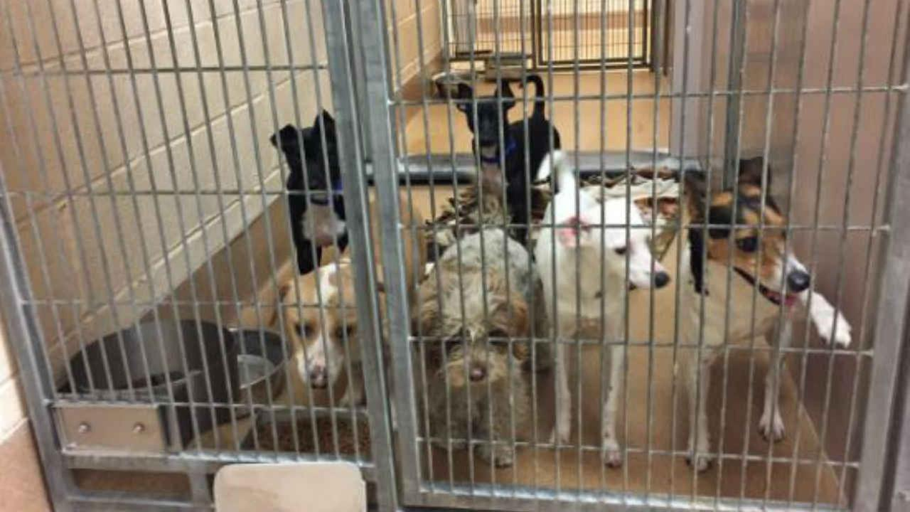
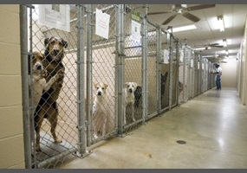
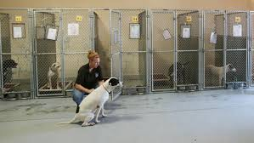
U.S. SHELTER SYSTEM

Slide 14
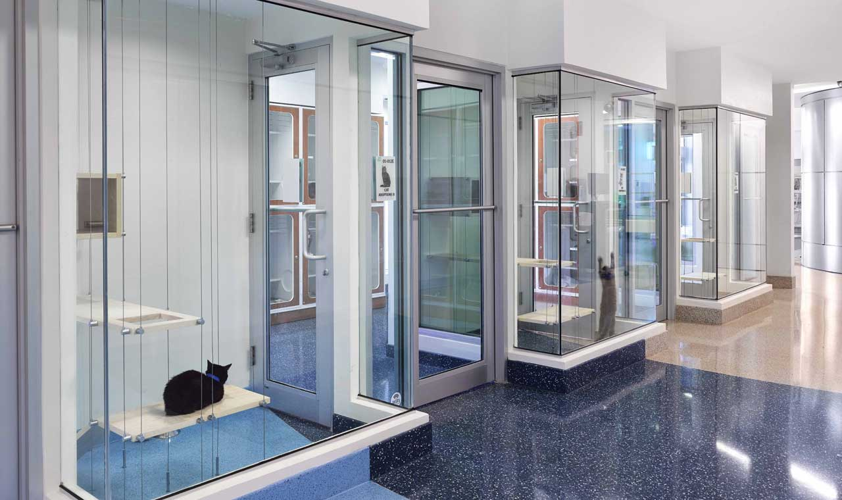
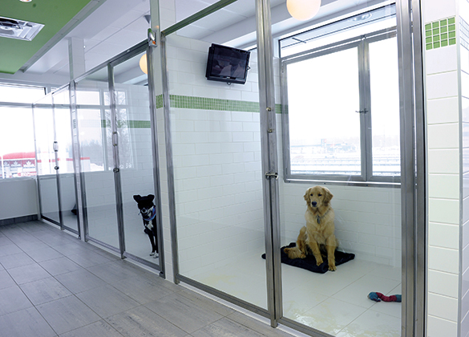
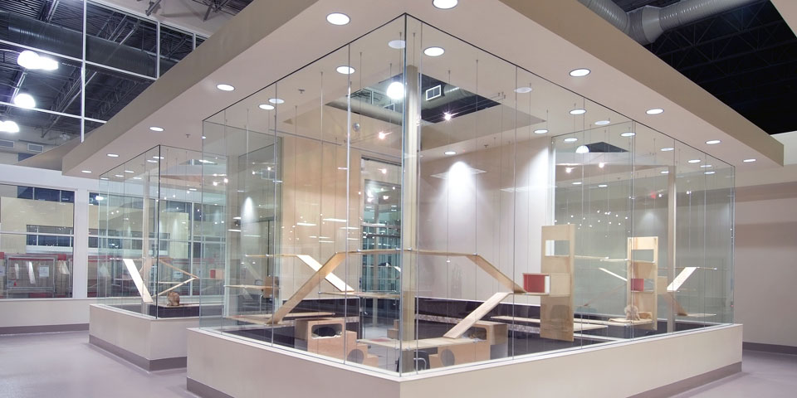
U.S. SHELTER SYSTEM

Slide 15
U.S. SHELTER SYSTEM HISTORY
Animal Control/Municipal
Nonprofit (Private) Shelters
Sanctuaries
Rescue Groups
Focus-Saving Lives & Population Management
High Volume Spay/Neuter
High Volume Adoptions

Slide 16
THE NEED FOR PET LIFE CARE PLANNING PET OWNER STATISTICS
68% of people have a pet in the US –that’s 85 million people
46% of pet owners own more than one pet (the overall average is 2 for dogs and cats, 3 for horses)
The state with the most pet dogs is Arkansas and cats is Vermont
Pet Health Insurance expenditures crossed $1.2B in 2017-a 23% increase over 2016

Slide 17
THE NEED FOR PET LIFE CARE PLANNING DEMOGRAPHIC DATA
About 28% of people live in a single household-approximately 35 million people.
Of older adults outside a nursing home or hospital, nearly 1/3 (11.3 million) live alone (37% women, 19% men).
5% of the 65+ population (3.9M) occupy nursing homes, assisted living or similar homes.
There are 78 Million Baby Boomers.
An average of 6,775 people die in the US each day or 2.5M people each year.

Slide 18
THE NEED FOR PET LIFE CARE PLANNING SHELTER STATISTICS
7.6 million pets enter animal shelters every year (3.9M dogs, 3.4M cats)
20% of dogs and 28% of cats taken to shelters each year are taken in by friends or family (1.73M total)
35%-50% of pets are killed in shelters each year.
An estimated 866,000 orphaned pets enter shelters each year and more than 400,000 die in the shelter because they have lost their owner.

Slide 19
What are the Options for pet owners?
Do Nothing
Euthanasia
3. Shelters & Rescues
4. Family or Friend
5. Life Care Center for Pets
Notes:
2/3rds of Americans do not have a living will. 60% do not have a will in place

Slide 20
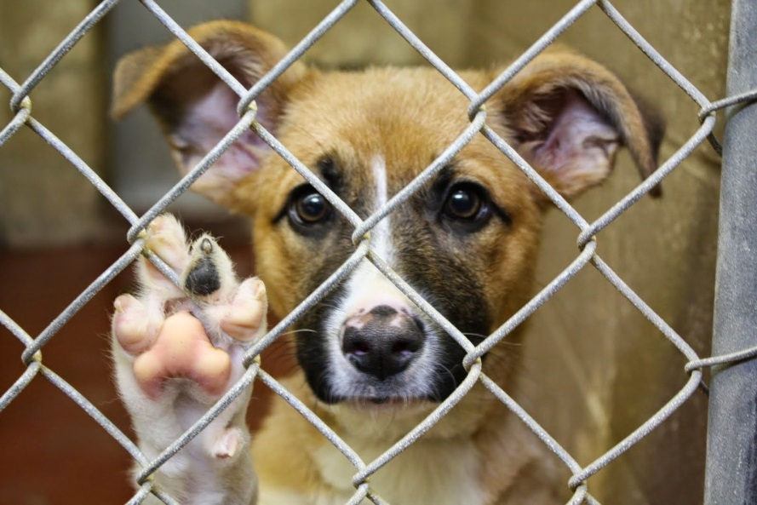
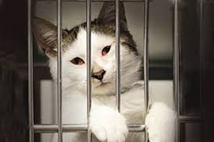
DO NOTHING OPTION
Family or Friend
Animal Control-Municipal Shelters
Private Shelters
Rescues
No Choice
No Control
No Peace of Mind
Notes:
No Choice/No Control

Slide 21
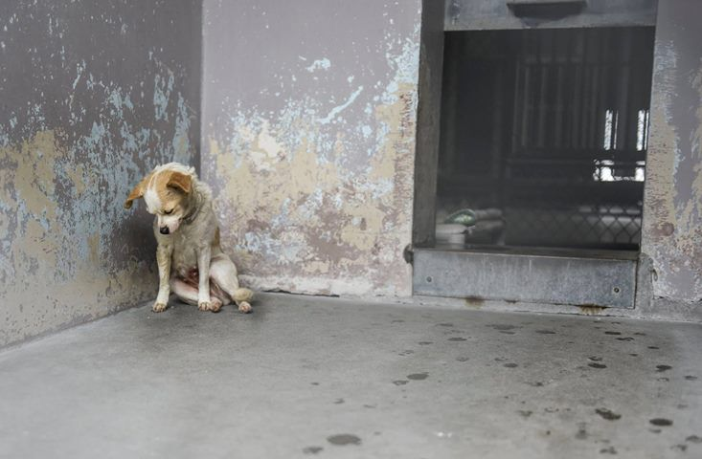
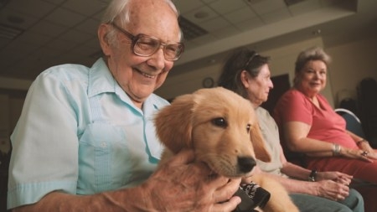
EUTHANASIA OPTION

Slide 22
SHELTER & RESCUE OPTIONS
Mission
Municipal Shelters: Under USDA-To protect the public illness and injury by keeping animals off the streets.
Private Shelters: Temporary Shelter-To rescue and find homes for pets rescued from municipal shelters or the general public.
Temporary Shelter Structure and Space
Access-Available in most communities
Overcrowded
Euthanasia Rates
May not have an active adoption program
Adoption Protocols & Home Checks
Limited Capacity and Resources
Pack and Clowder Limitations (Rescues)
Notes:
Pets can be seized and euthanized by AC in a matter of days.

Slide 23
FAMILY OR FRIEND OPTION
Undocumented
60-66% of Americans do not have a will or living will
Only 9% of people with wills have made provisions for their pets
c. 20% of dogs and 28% of cats taken to shelters each year are taken in by family members (1.73M total)
Taken by Animal Control & Municipal Shelter if no one steps forward
Notes:
I.E. Same as the Do Nothing Option
Pets are Property; Mention the movement to change pet status that they are not property. Non-Human (Animal)Rights vs Animal Welfare #Not Property Movement

Slide 24
FAMILY OR FRIEND OPTION
2. Documented
a. Will
b. Contractual Agreement
c. Pet Trust
Notes:
Pets are Property; Pet Trusts – all 50 states allow pet trusts

Slide 25
BEQUEST/WILL
Takes effect upon death event
Disburses Property – Does not Enforce Ongoing Activities
Provisions are honorary and not enforceable (pets cannot sue)
Waiting Periods/Probate/Disputes
Doesn’t allow for Fund Disbursement Over Time
Pet Care Requirements cannot be documented
Pet Care Is not provided for in case of accident, or otherwise incapacitated.
Does not provide for interim pet care
Notes:
Pets are Property; Pet Trusts – all 50 states allow pet trusts

Slide 26
CONTRACTUAL AGREEMENT
Pets are Property-Covered under Property Law
Property can be transferred in a consensual transaction
Pet Protection Agreement or Pet Life Care Agreement-An agreement that names your pet guardian(s) who will be responsible for your pets. It also allows you to specify how to care for the animals. Can be used in temporary emergencies or permanent situations.
Notes:
Pets are Property; Pet Trusts – all 50 states allow pet trusts

Slide 27
Pet trusts
A pet trust is a legal arrangement to provide care for a pet in the event of death or disability of the owner.
Pet trusts stipulate that in the event of a grantor’s disability or death a trustee will hold property (cash, for example) “in trust” for the benefit of the grantor’s pets.
Notes:
Since the change in the Uniform Probate Code to all for Pet Trusts, it is estimated that over 1M dogs have been named primary beneficiary of asses held in trust. The Uniform Trust Code is a model law in the United States, which although not binding, is influential in the states, and used by many as a model law. As of July 2012, 25 states have adopted some substantive form of the UTC with three others having introduced it into the legislature for adoption.

Slide 28
Pet trusts
A testamentary trust is created by a will and arises after the death of the settlor.
A living trust or inter vivos trust is created during the settlor's lifetime by a trust instrument.
A trust may be revocable or irrevocable; in the United States
A trust is presumed to be irrevocable unless the instrument or will creating it states it is revocable, except in California, Oklahoma and Texas, in which trusts are presumed to be revocable until the instrument or will creating them states they are irrevocable.
An irrevocable trust can be "broken" (revoked) only by a judicial proceeding.
Notes:
The states that have enacted a version of the Uniform Trust Code are Alabama, Arizona, Arkansas, Florida, Kansas, Kentucky, Maine, Maryland, Massachusetts, Michigan, Minnesota, Mississippi, Missouri, Montana, Nebraska, New Jersey, New Hampshire, New Mexico, North Carolina, North Dakota, Ohio, Oregon, Pennsylvania, South Carolina, Tennessee, Utah, Vermont, Virginia, West Virginia, Wisconsin, and Wyoming.

Slide 29
Pet trusts
All 50 states plus the District of Columbia have a pet trust law.
Minnesota was the last state to enact a pet trust law in 2016.
Uniform Trust Code - 31 states and the District of Columbia have enacted a version of the Uniform Trust Code.
Uniform Probate Code - Although the UPC was intended for adoption by all 50 states, the original 1969 version of the code was adopted in its entirety by only sixteen states. The remaining states have adopted various portions of the code in a piecemeal fashion.
Notes:
The Uniform Trust Code is a model law in the United States, which although not binding, is influential in the states, and used by many as a model law. As of July 2012, 25 states have adopted some substantive form of the UTC with three others having introduced it into the legislature for adoption. The states that have enacted a version of the Uniform Trust Code are Alabama, Arizona, Arkansas, Florida, Kansas, Kentucky, Maine, Maryland, Massachusetts, Michigan, Minnesota, Mississippi, Missouri, Montana, Nebraska, New Jersey, New Hampshire, New Mexico, North Carolina, North Dakota, Ohio, Oregon, Pennsylvania, South Carolina, Tennessee, Utah, Vermont, Virginia, West Virginia, Wisconsin, and Wyoming.

Slide 30
PET TRUST
Grantor: the person who creates the Trust (also known as “settlor,” /“trustor”/Grantor). Pet Owner
Trustee: the person, business entity or public body, that agrees to hold the property or assets. As Designated or Perpetual Care
Enforcer: the person, business entity or public body that ensures that the beneficiary adheres to the stipulations of the trust. Perpetual Care
Principal: the property or assets themselves, including money, which is held in the Trust and managed by the Trustee. The Pet Trust
Beneficiary: the person or people who ultimately receive the property or assets in the Trust. Primary Caregiver/Secondary Caregiver
Notes:
Comment: We recommend identifying a primary and secondary Caregiver. Also, note that some trusts could be set up with independent trustee and PC as Caregiver and the pet becomes a resident of PC Life Care Center.

Slide 31
VIRGINIA TRUST LAW
Adopted Uniform Trust Code in 2005
Also adopted Pet Trust Law
The sole trustee and sole beneficiary of a trust cannot be the same person-does not allow the person who manages the assets to receive the benefits of the same trust they manage.

Slide 32
VIRGINIA TRUST LAW
Universal Citation: VA Code § 64.2-726 (2016)
A. A trust may be created to provide for the care of an animal alive during the settlor's lifetime. The trust terminates upon the death of the animal or, if the trust was created to provide for the care of more than one animal alive during the settlor's lifetime, upon the death of the last surviving animal.
Funds from the trust may be applied to any outstanding expenses of the trust and for burial or other post death expenditures for animal beneficiaries as provided for in the instrument creating the trust.

Slide 33
VIRGINIA TRUST LAW
Universal Citation: VA Code § 64.2-726 (2016)
C. A trust authorized by this section may be enforced by a person appointed in the terms of the trust or, if no person is so appointed, by a person appointed by the court. A person having an interest in the welfare of the animal may request the court to appoint a person to enforce the trust or to remove a person appointed. The appointed person shall have the rights of a trust beneficiary for the purpose of enforcing the trust, including receiving accountings, notices, and other information from the trustee and providing consents. Reasonable compensation for a person appointed by the court may be paid from the assets of the trust.

Slide 34
VIRGINIA TRUST LAW
Universal Citation: VA Code § 64.2-726 (2016)
E. Property of a trust authorized by this section may be applied only to its intended use, except to the extent the court determines that the value of the trust property exceeds the amount required for the intended use. Except as otherwise provided in the terms of the trust, property not required for the intended use shall be distributed to the settlor, if then living. If the settlor is deceased, such property shall be distributed pursuant to the residuary clause of the settlor's will if the trust for the animal was created in a preresiduary clause in the will or pursuant to the residuary provisions of the inter vivos trust if the trust for the animal was created in a preresiduary clause in the trust instrument; otherwise, such property shall be distributed to the settlor's successors in interest.

Slide 35
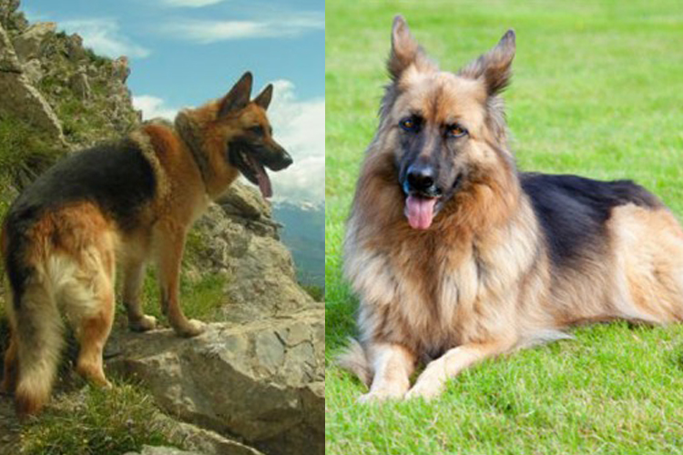
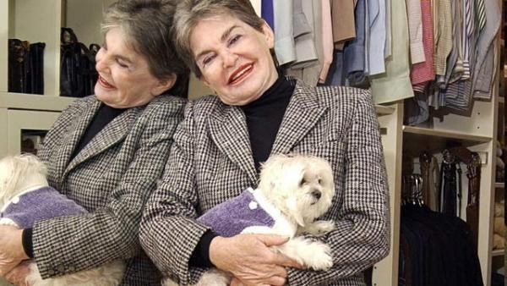
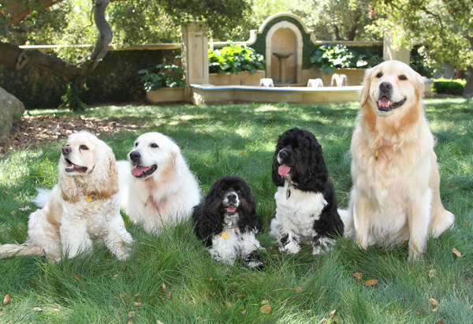
LARGEST PET TRUSTS

Slide 36
Pet trust LIMITS
Helmsley Case – Trouble, the Maltese: $12,000,000 reduced to $2,000,000
Copland Case – 2 Cats, Polk-a-dot & Ginny: $4,761,346 reduced to $440,000
Average Pet Trust to Shelters or Veterinary Schools - $10,000 to $45,000 per dog/cat; $65,000-$85,000 per horse
Notes:
Trouble’s expenses were $190,000 a year (including $100,000 for Security and $60,000 for caregiver). He lived from 2007 to 2009

Slide 37
Pet trust FuNDING
Average Life Expectancy/Cost:
Large Dog = 8 yrs/$8,000
Small Dog = 13 yrs/$15,000
Indoor Cat = 12-18 yrs/$9,500-$15,000
Outdoor Cat = 2-5 yrs/$2,000-$4,000
Horses = 25-33 yrs/$85,000-$105,000
Large Bird (Macaw/Cockatoo)= 50-65 yrs/$115,000

Slide 38
Pet trust ISSUES
21 Year Limit in some states-Alaska, Michigan, Montana, & New Jersey
Offspring provisions – In gestation
Clarification of “pets” – domestic, exotic, livestock
Notes:
The oldest reported cat lived to be an amazing 28 years old.

Slide 39
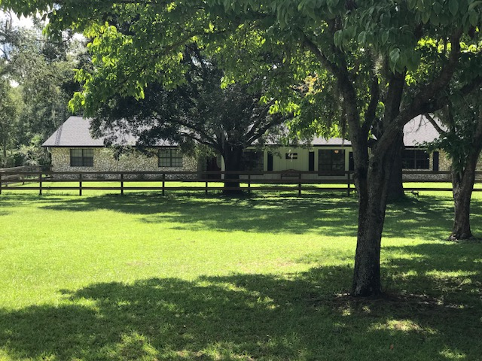
LIFE CARE CENTER FOR PETS
An organization and facility dedicated to pets left behind by the death or disability of their owner.

Slide 40
HOW DOES IT WORK?
Process
All Pets
Interviews & Consultation
Meetings with Legal Counsel & Financial Advisor
Pet Trust Agreement and Trust Documentation
Pet becomes a resident (property) of Perpetual Care Life Care Facility
Pet may be adopted, placed in an extended care home or become permanent resident
Notes:
All Pets: Cats,

Slide 41
HOW DOES IT WORK?
Finances
Trust Fund or insurance beneficiary
Stipend for Caregiver
Oversight
Veterinary Certification of Health
Home Visits
Photos, videos, etc.
Compensation
Medical Expenses
Administration Fee
Travel & Transport
5. Remainder Funds Donated to Perpetual Care

Slide 42
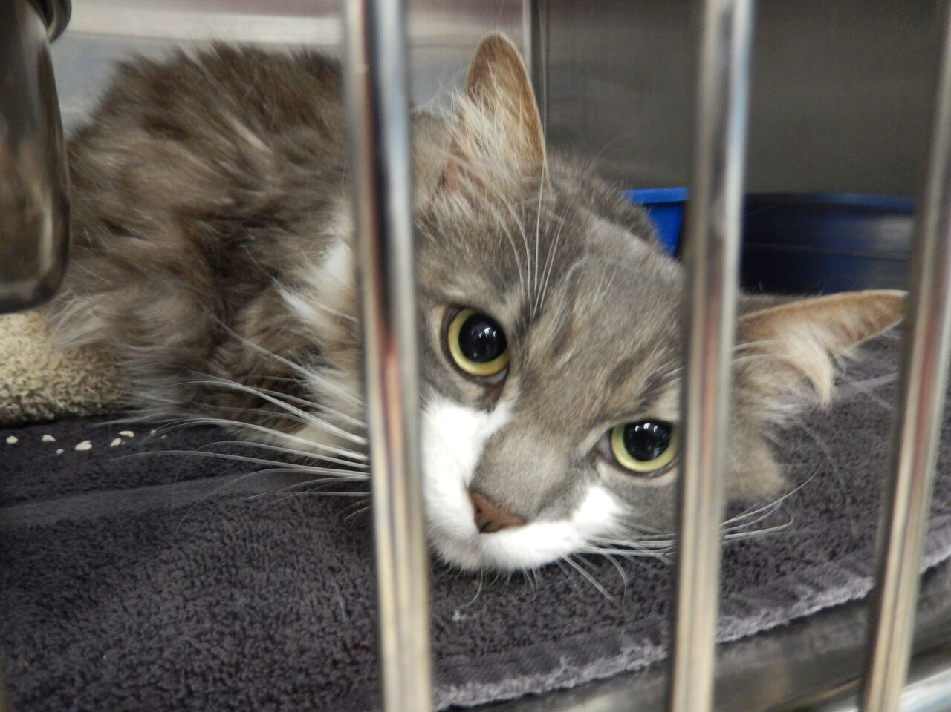
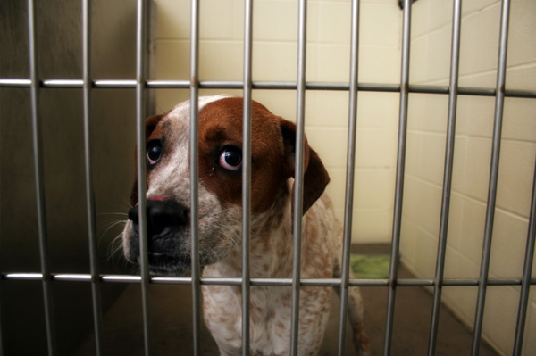
HOW ARE REMAINDER FUNDS AND GENERAL DONATIONS USED?
Shelter Pet Sponsorships
Notes:
Trust Funds are considered Fee for services. If funds remain beyond the life of the pet, they must be specified for donation.

Slide 43
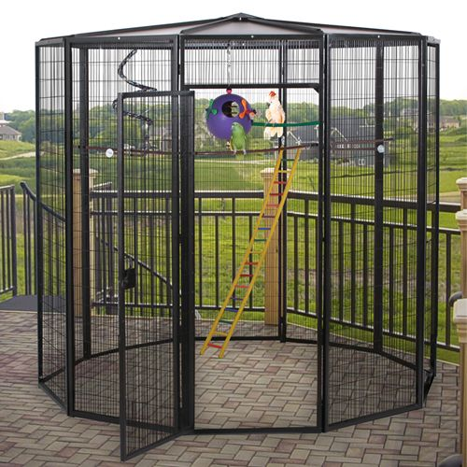
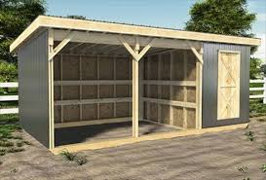
HOW ARE REMAINDER FUNDS AND GENERAL DONATIONS USED?
Facility Repairs, Improvements, and Expansion
Block Shed Renovations
c. Aviaries
b. Horse Lean To
Notes:
Trust Funds are considered Fee for services. If funds remain beyond the life of the pet, they must be specified for donation.

Slide 44
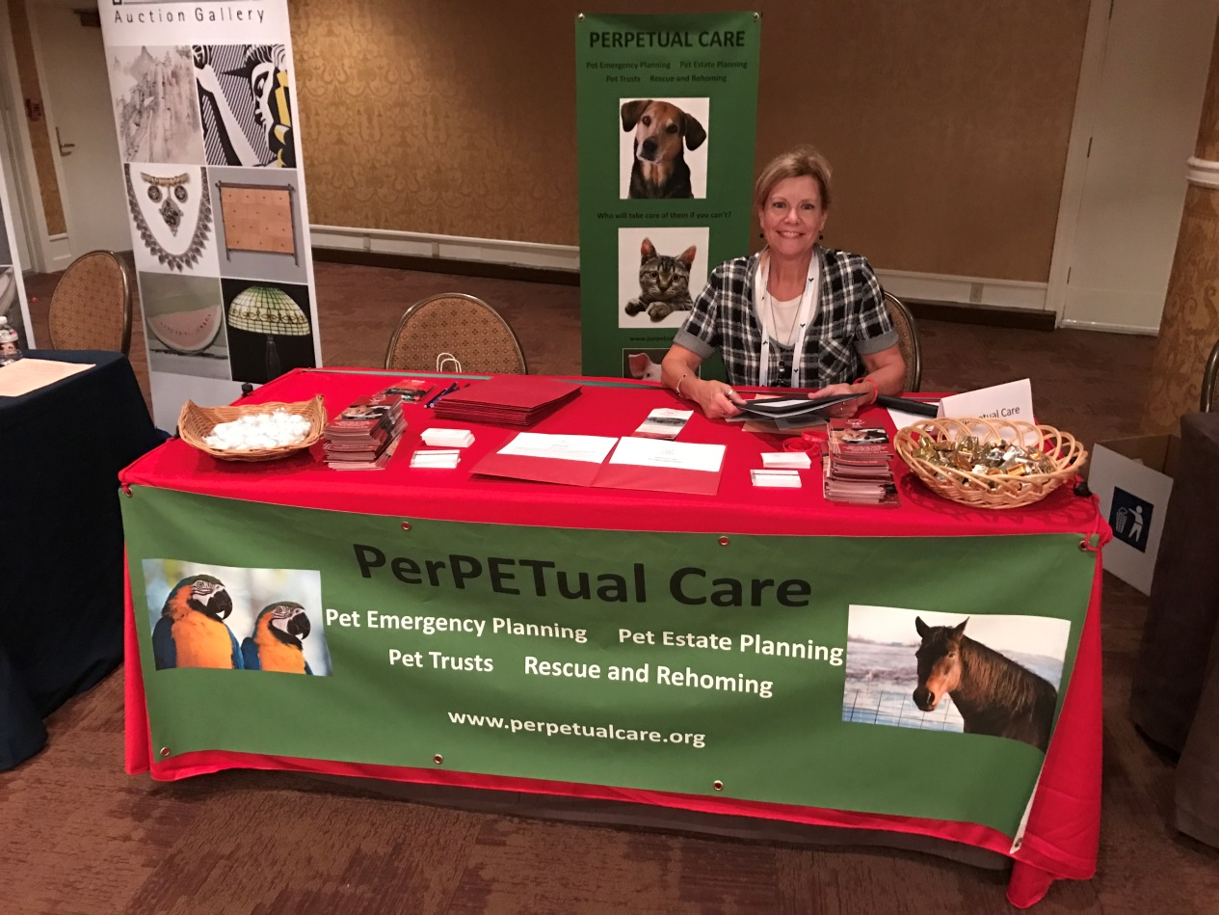
HOW ARE REMAINDER FUNDS AND GENERAL DONATIONS USED?
Education – Information - Support
Notes:
Trust Funds are considered Fee for services. If funds remain beyond the life of the pet, they must be specified for donation.

Slide 45
Other Services
Emergency Alert Cards
References and Resources
Pet Life Care Agreement Templates
Life Care Share Agreements
Independent Trustee or Enforcer
Notes:
Pets can be seized and euthanized by AC in a matter of days.

Slide 46
LIFE CARE SHARE AGREEMENT
The Senior Life Care Center Option
Keeps pets with owners
Provides care for the pet when the owner cannot care for them
Provides comfort and purpose to owner and pet
Saves pets from shelters
Transitions into Pet’s Life Care Center Option
Notes:
Pets can be seized and euthanized by AC in a matter of days.

Slide 47
LIFE CARE SHARE AGREEMENT
Perpetual Care Provides:
Home environment
Basic Care-food, water, shelter
Love and Affection
Play and exercise
Fee Schedule Includes:
Per visit cost
Medical Expenses
Notes:
Pets can be seized and euthanized by AC in a matter of days.

Slide 48
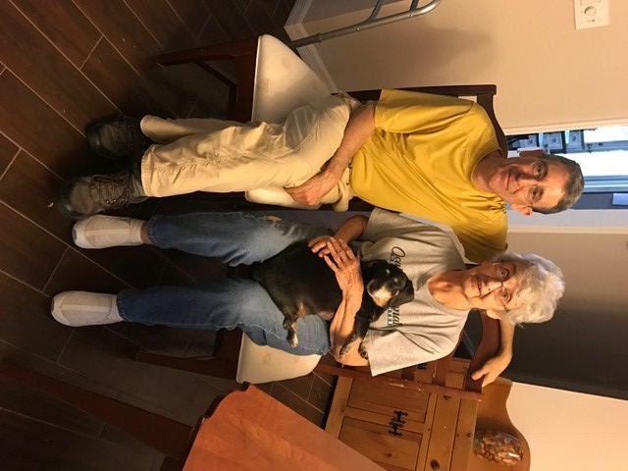
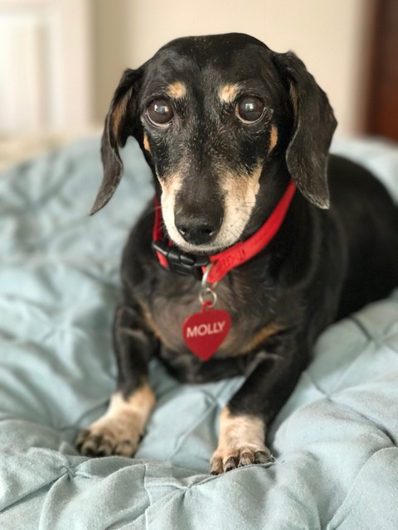
LIFE CARE SHARE AGREEMENT

Slide 49
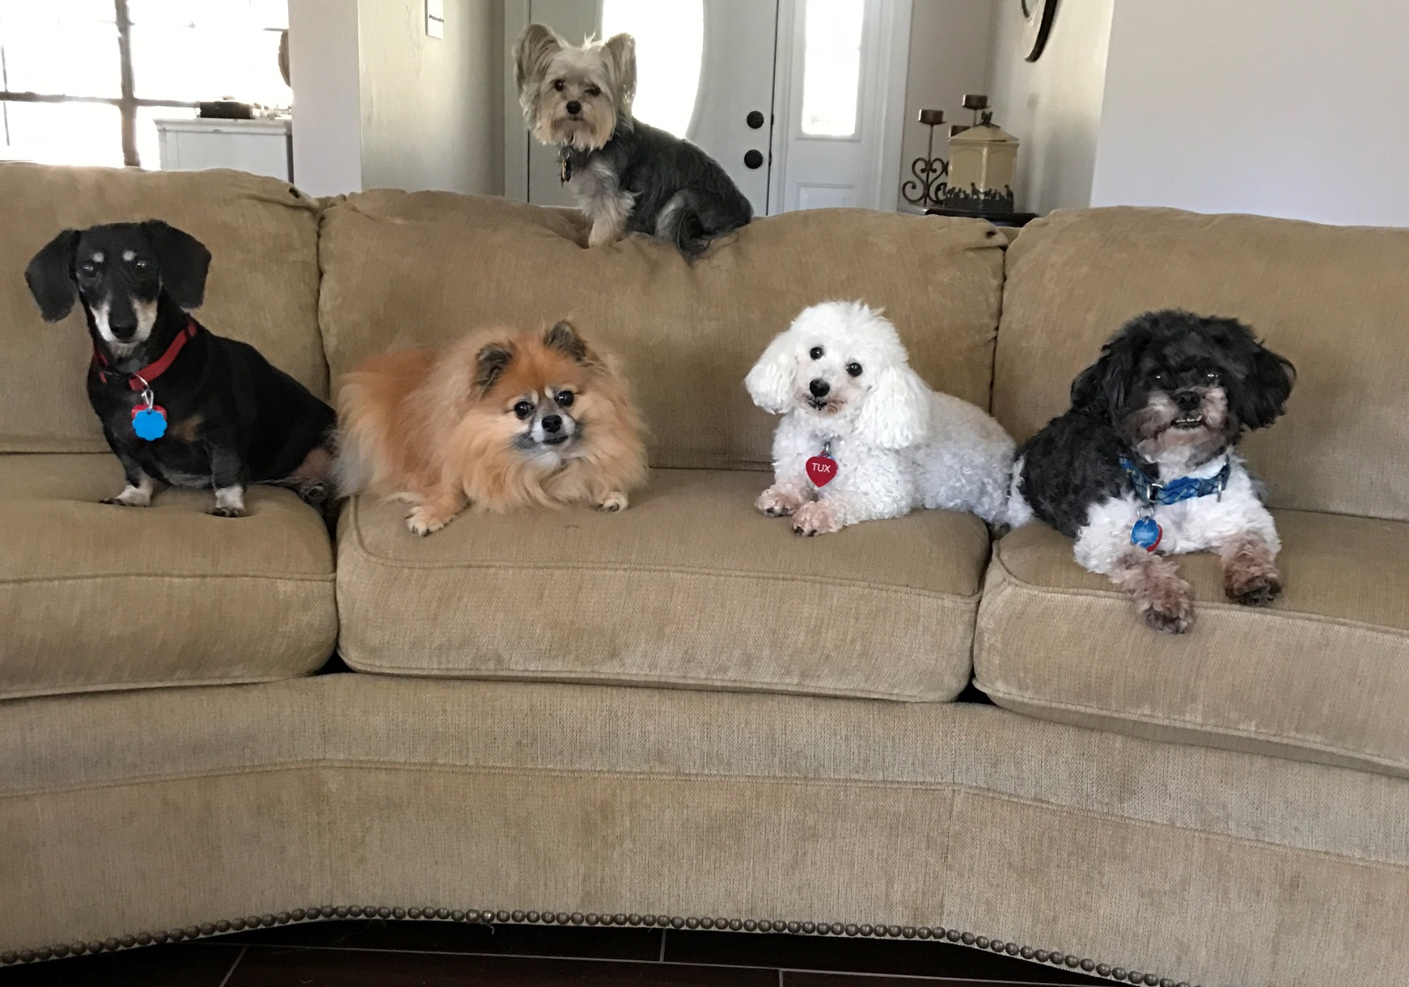
2018 RESIDENTS

Slide 50
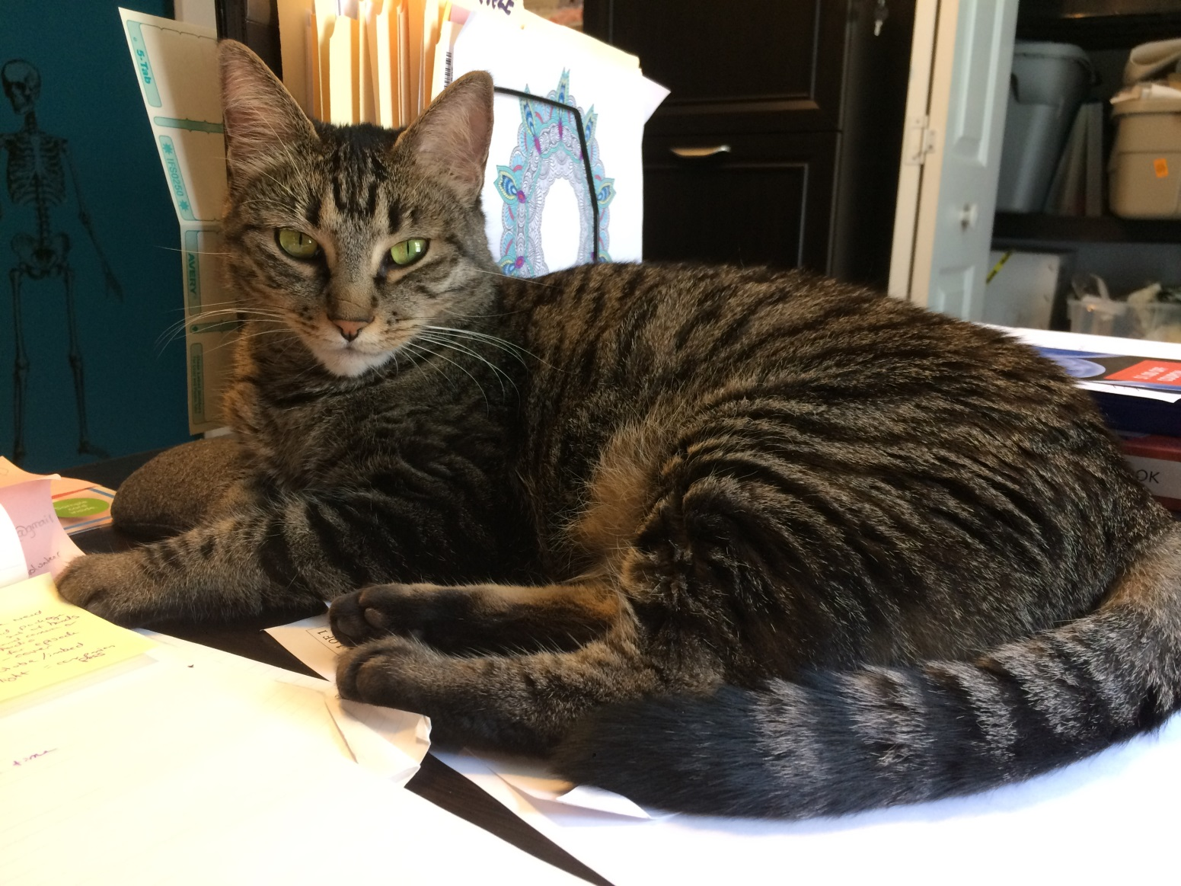
2018 RESIDENTS

Slide 51
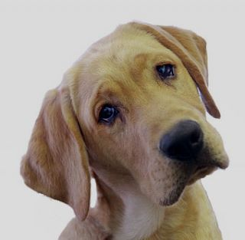
Questions?

