Slide 1
Fundamentals of Pooled Special Needs Trusts and the Disbursement Process
Presented by Joanne Marcus, MSW and Karen Dunivan Konvicka, J.D. Commonwealth Community Trust
Richmond, Virginia
(804) 740-6930 | www.trustCCT.org

Slide 2
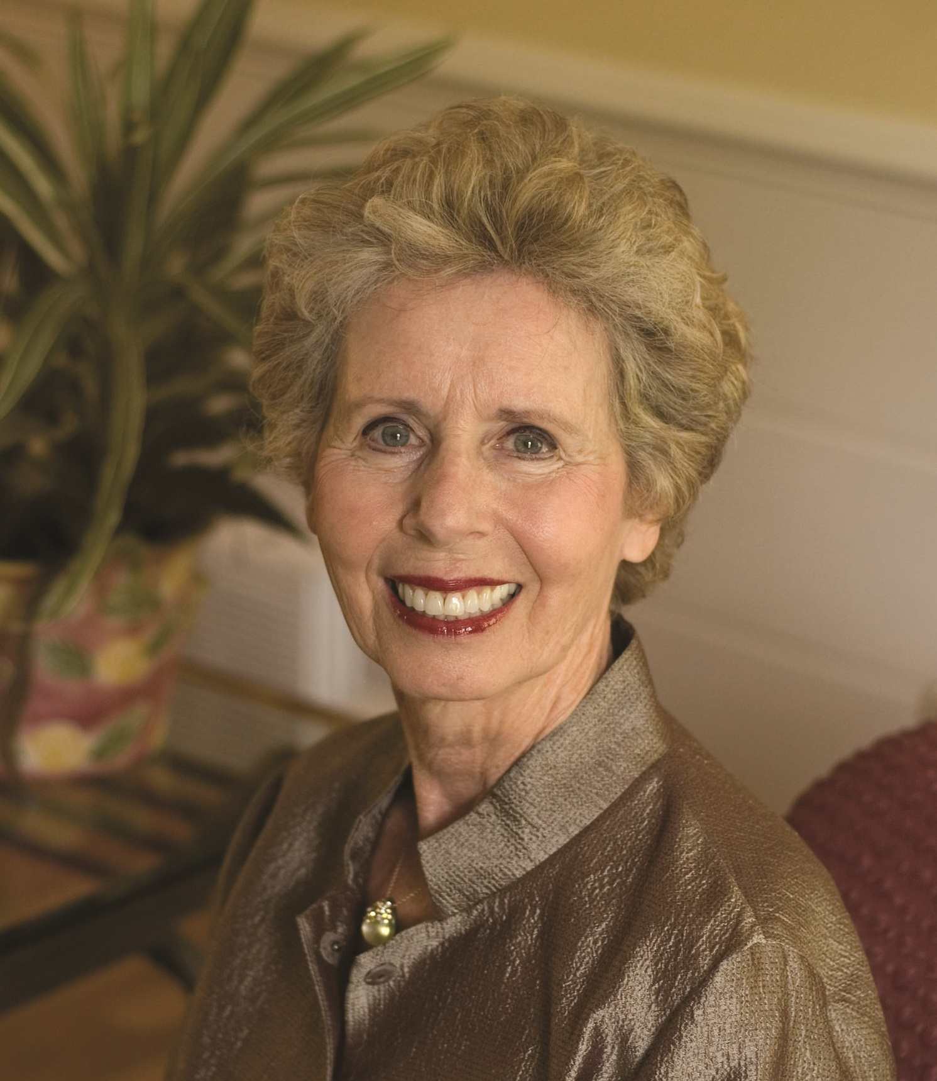
Joanne Marcus, MSW President & CEO
Joanne Marcus has a Master’s Degree in Social Work and serves as the President and CEO of Commonwealth Community Trust (CCT). She brings to CCT 37 years of experience in nonprofit administration and served as the Executive Director of CCT for 21 years before being named President and CEO. Under her leadership, CCT has grown to serve over 2,000 trust beneficiaries throughout the United States. Ms. Marcus is frequently asked to speak to professional groups and community organizations nationwide.
jmarcus@trustCCT.org
(804) 740-6930
www.trustcct.org

Slide 3
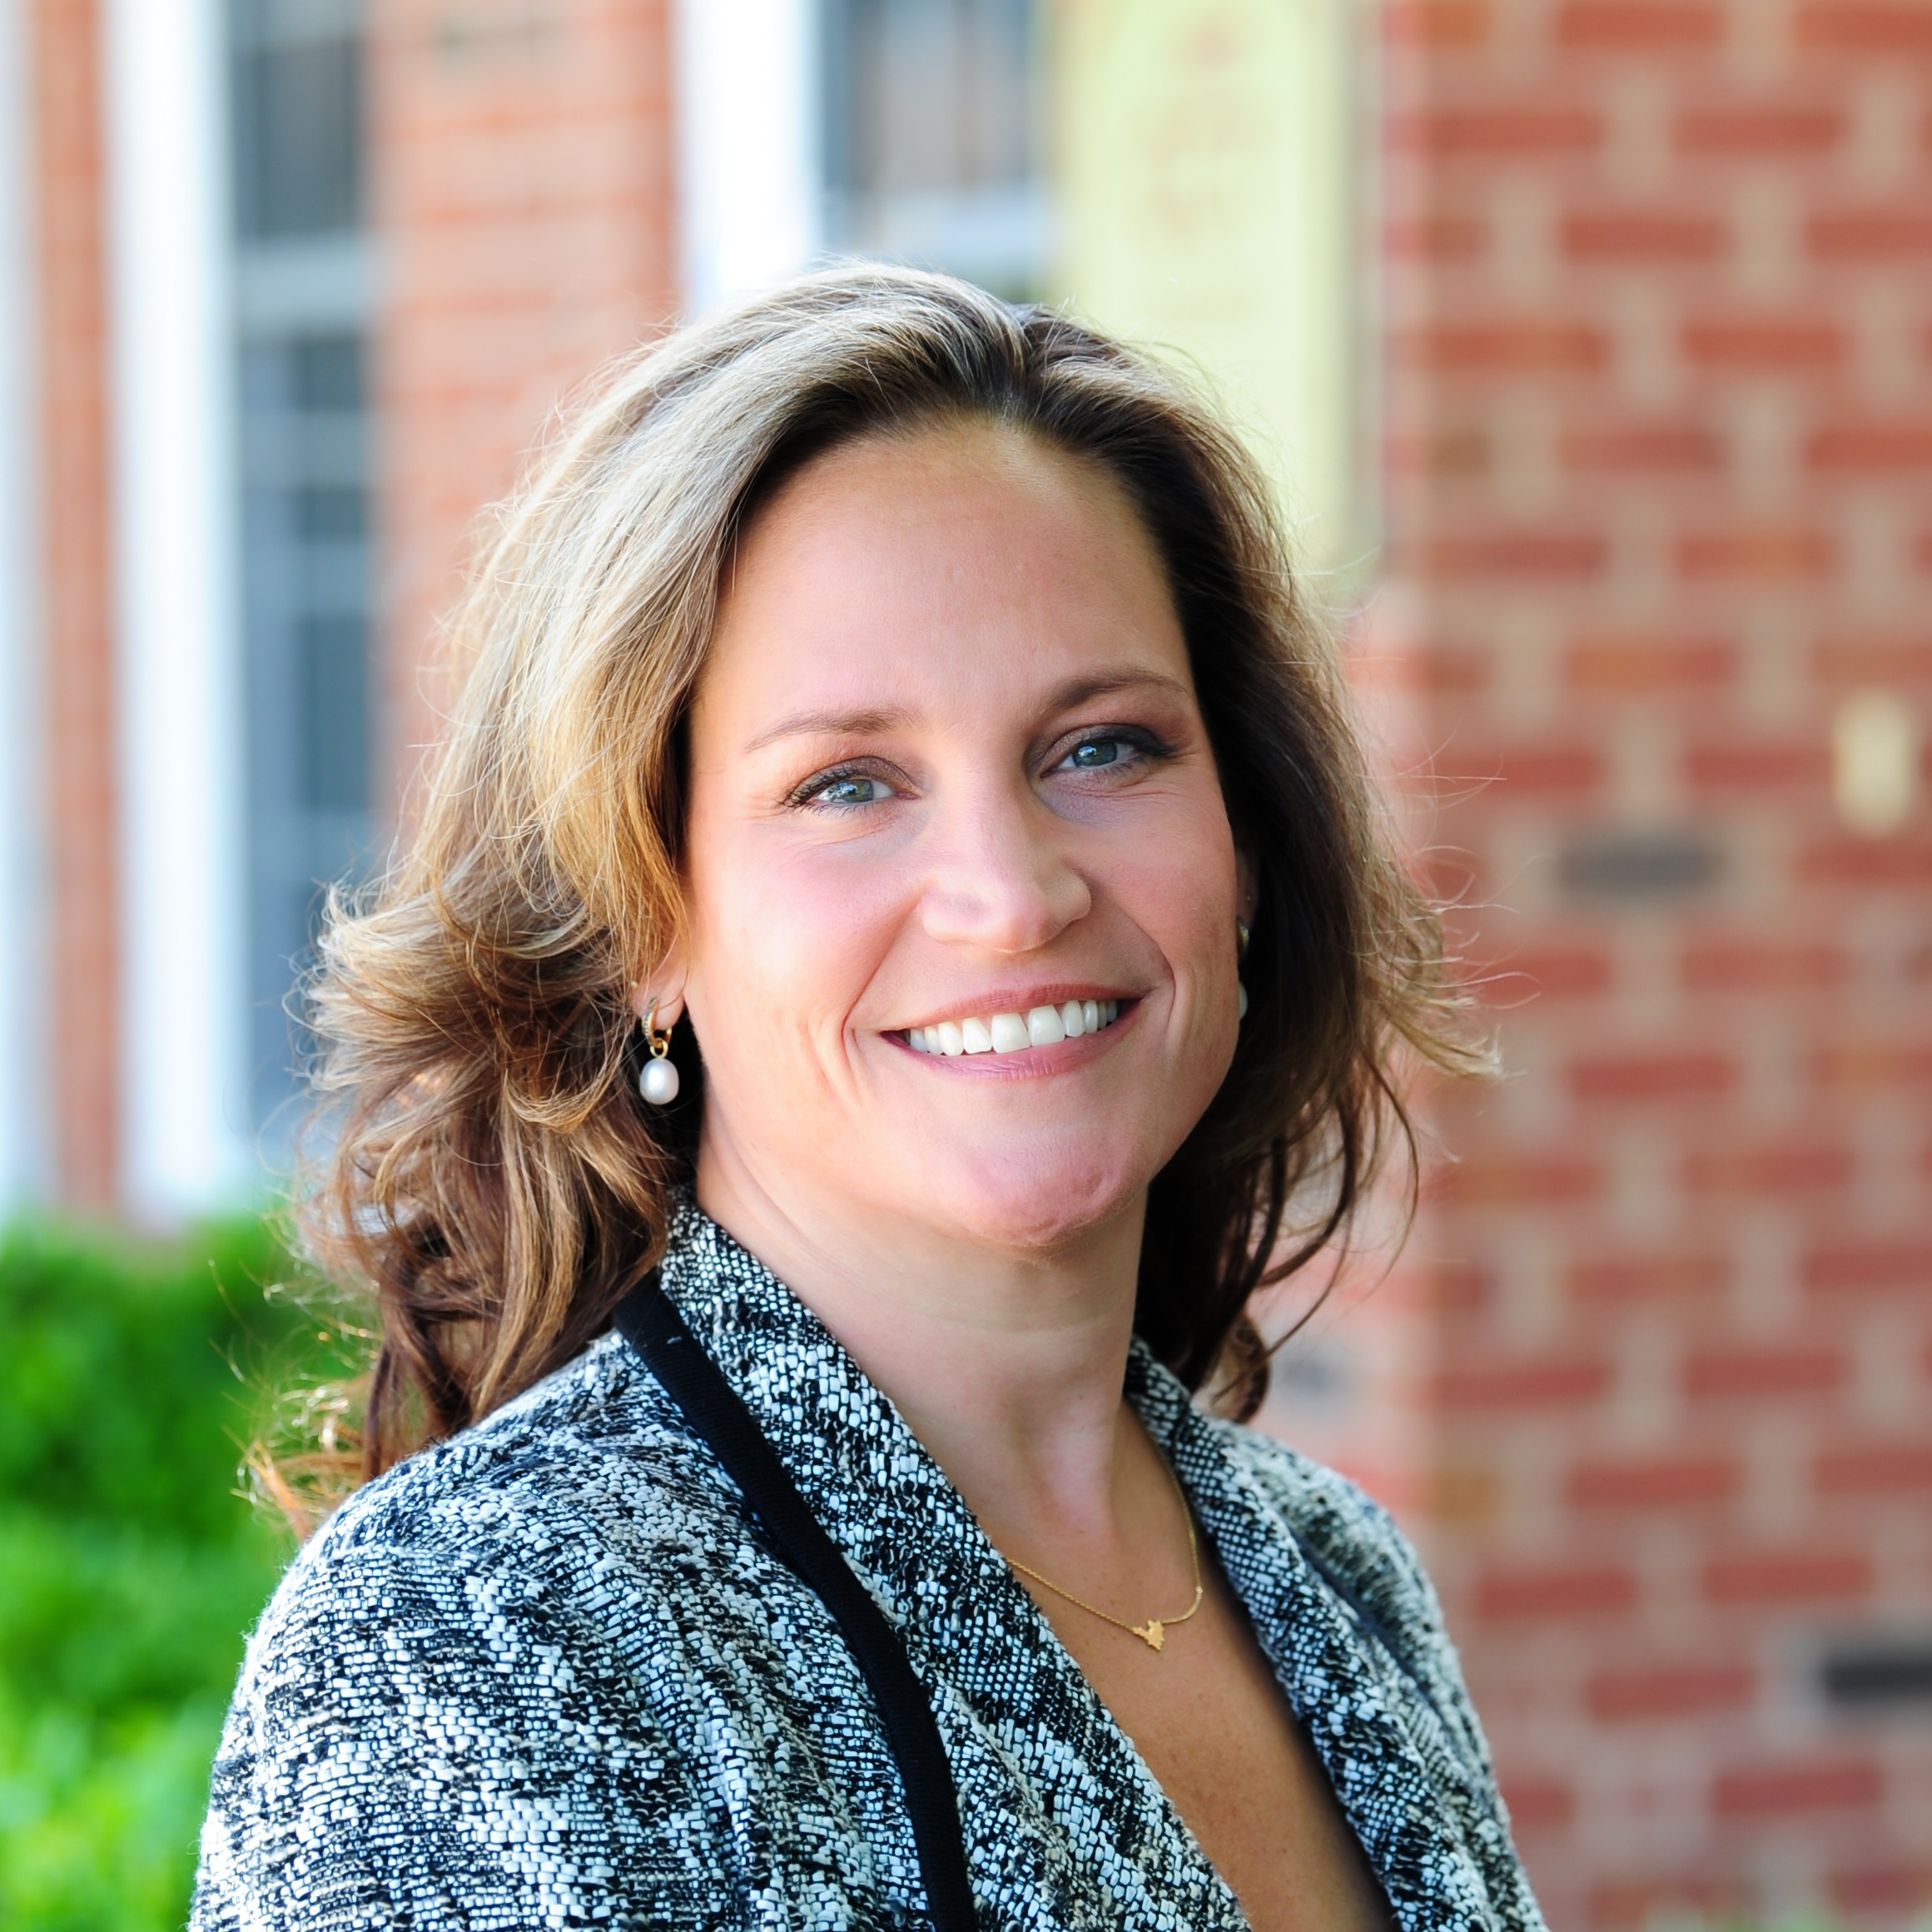
Karen Dunivan Konvicka, J.D. Director of Client Services
Karen Dunivan Konvicka serves as Director of Client Services and General Counsel for Commonwealth Community Trust (CCT). When in private practice, Ms. Konvicka specialized in public benefits law and estate and trust planning and administration for individuals with special needs. Ms. Konvicka maintains her memberships in the Virginia State Bar, National Academy of Elder Law Attorneys (NAELA), and the Virginia Academy of Elder Law Attorneys (VAELA) and enjoys continuing to educate attorneys and families about special needs planning from the pooled trust perspective.
kkonvicka@trustCCT.org
(804) 740-6930
www.trustcct.org

Slide 4
What is a Pooled Special Needs Trust?
Trust arrangement for disabled individuals in which assets are held for their benefit while preserving their public benefits
Managed by a non-profit organization
Created by one Master Trust Agreement
Clients “join” by signing the Joinder Agreement
Lower fees and lower minimum funding requirements than most financial institutions and professional fiduciary options
*See 42 U.S.C. § 1396 p(d)(4)(C)

Slide 5
SNTs: Individual and Pooled
Individual
Typically administered by a family member or institutional trustee (see Slide #15)
Pooled
Assets are “pooled” to provide lower administrative fees, opportunity for higher returns on investments
Although most do, beneficiaries are not required to have a specific disability
Trustee must file taxes and other regulatory filings
Trustee may not have knowledge of the rules governing Supplemental Security Income (SSI) and/or Medicaid
Staff has expertise in public benefits rules
Administered by a non-profit organization
All beneficiaries have a disability as defined by Social Security Administration (SSA)
Trust tax returns and filings completed by nonprofit
Usually, minimum funding requirement of $350,000 and thus higher administrative trust fees
Accepts modest and large funded subaccounts
Each type of SNT has advantages that require careful considerations to determine which option best meets your client’s needs.
*See 42 U.S.C. § 1396 p(d)(4)(A)-(C)

Slide 6
Benefits of Using a PSNT
Low Fees & Funding Requirements
Pooled Trust Administration
Expertise
Greater Investment Opportunities
Knowledgeable &
Experienced Staff Members

Slide 7
Role and Responsibilities of the Trust Administrator
Utilize the funds for the “sole benefit” of the Trust Beneficiary
Promote the best interest of the Beneficiary
Avoid potential loss of government benefits by inappropriate distributions
Invest trust assets wisely and follow fiduciary requirements
Maintain accurate accounting
Trustee has complete discretion over distributions

Slide 8
Role of an Advocate
Trusted and close to the Beneficiary
Familiar with wants and needs of Beneficiary
Has access to financial and confidential information
Makes requests for disbursements from the trust
Can be:
Beneficiary
Relative
Guardian or Power of Attorney
Caseworker or Other Stakeholder

Slide 9
Fees and Funding Requirements
Varies among pooled trusts, but generally:
Enrollment Fees
Trust Administration/Investment Fees
Affordable ongoing fees when compared to financial institutions and other professional trustee options
Funding minimum in many cases may be as low as $10,000

Slide 10
Allowable Contributions
PSNTs may vary in what is considered an acceptable contribution:
Some PSNTs accept cash assets only; other PSNTs accept other assets such as real estate or business interests
Some PSNTs accept and hold as custodian inherited IRAs and Medicare Set-Aside accounts
PSNTs may also be named as the beneficiary of a Military Survivor Benefit Plan for the benefit of a special needs dependent of a service member

Slide 11
Two Types of PSNTs:
Third-Party | First-Party
Grantor can be any third-party individual such as a parent, family member or friend. | Federal Statute requires that the Grantor be the individual, the individual’s guardian, parent, grandparent, or Court. The authority granted by a Power of Attorney is accepted.
Typically funded by Estate Plans, Life Insurance Policies, Investments, Retirement Accounts or other assets of third party | Funds belong to the Beneficiary, usually from a personal injury or workers’ compensation award, direct inheritance, the beneficiary’s own funds or Social Security back payment.
Revocable or Irrevocable | Irrevocable
NOT subject to Medicaid payback | Subject to Medicaid payback
No Age Limitation | A transfer of assets penalty may apply if the Beneficiary is 65 years old or older (varies by state and by benefit received). Contact CCT for more information.

Slide 12
Source of Law: Third-Party PSNT POMS I01120.200D.2
A trust is not a countable resource IF all the following are true:
It is funded by the assets of a third-party (anyone besides the beneficiary)
It does not grant beneficiary the ability to revoke or terminate
It does not grant the beneficiary the authority to direct distributions (this power lies with the trust administrator)

Slide 13
4-Point Client Checklist: Third-Party
Does the Beneficiary receive means-tested benefits such as SSI and/or Medicaid?
Will an inheritance left directly to the Beneficiary jeopardize his or her benefit eligibility?
Does your client wish to ensure financial support for the Beneficiary when he or she is no longer able to provide?
Is the Beneficiary easily taken advantage of or not able to manage his or her own finances?

Slide 14
SECURE Act and See-through Accumulation Trust
The SECURE Act limited the ability of most non-spouse beneficiaries of inherited IRAs to “take the stretch” on inherited IRA’s – most non-spouse beneficiaries of inherited IRAs can no longer withdraw from that retirement account using life expectancy.
EXCEPTION – disabled beneficiaries of an inherited IRA are still permitted to “take the stretch” even when the IRA is assigned to a trust for their benefit, if the trustee has complete discretion over distributions to the beneficiary.
This means that a PSNT can still “take the stretch” on an inherited IRA for the beneficiary – avoiding heavy income taxation that would be required when the IRA funds are disbursed more quickly.
*See Setting Every Community Up for
Retirement Enhancements (SECURE) Act,
Effective Jan. 1, 2020

Slide 15
Source of Law: First-Party PSNT
Omnibus Reconciliation Act of 1993
Created by Federal Law 42 U.S.C. §1396p(d)(4)(A) – (C)
(d)(4)(A): individual special needs trusts
(d)(4)(C): pooled special needs trusts
Code of Federal Regulations: 20 C.F. R. §416
SSA-POMS-Program Operations Manual System
SI 01120.203D.
State Laws and Regulations for Medicaid recipients
Medicaid Manuals

Slide 16
5-Point Client Checklist: First-Party
Does your client currently receive Supplemental Security Income (SSI) and/or Medicaid?
Might your client receive benefits in the future?
Is your client easily taken advantage of or not able to manage his or her own finances due to a disability?
Could your client benefit from a professional with knowledge of the rules governing SSI and/or Medicaid?
Does your client have assets in his/her own name, such as personal injury, proceeds from divorce or home sale, directly paid inheritance, beneficiary’s own funds or back SSI payments?

Slide 17
65 and Over: Transfer of Assets Penalty Exception
Those over 65 who transfer assets to a First-Party PSNT may face a transfer of assets penalty – a number of months they must wait before receiving benefits based on the amount transferred.
An important exception:
Transfers to a PSNT for the benefit of a disabled child by a person over 65 are exempt transfers and will not cause a transfer penalty.

Slide 18
Public Benefits Primer
Disability as defined by the Social Security Administration (SSA)
Adult
The individual must have a severe, medically determinable physical or mental impairment which is expected to last for one year or to result in death.
The impairment must make the individual unable to engage in “substantial gainful activity.”
Minor (under 18)
The child must have a physical or mental condition(s) that very seriously limits his or her activities.
The condition(s) must have lasted, or be expected to last, at least one year or result in death.
Source: Social Security Handbook (disability.gov)

Slide 19
Supplemental Security Income (SSI):
What happens if one is disabled and impoverished?
Monthly monetary allowance that is intended to pay for basics like food and shelter
Means-tested benefit for disabled persons who are impoverished
Adults are eligible if they are:
Disabled
Have no more than $2,000 in countable resources
AND
Below the Federal Benefit Rate – currently $841/month, as of January 2022

Slide 20
Medicaid
Federal health insurance program for persons who are aged, blind and disabled with qualifying low incomes and resources
Administered by the States – some states have different eligibility requirements
Administered through the local Department of Social Services
For simplicity’s sake – eligibility for Medicaid is the same as SSI
Cap on resources and income

Slide 21
Guidelines for Disbursements
When considering whether to approve a disbursement request, the following best practices can be used as a guide for decision-making:
For a beneficiary receiving SSI and/or Medicaid, will the request jeopardize benefits?
Is the request for the sole benefit of the beneficiary?
Are there adequate funds in the trust to cover the request?
Is the request prudent?
For a Third-Party Trust, is the request consistent with the intent of the Grantor(s)?
Is the request consistent with the beneficiary’s budget and objectives?

Slide 22
Is it Income? For Beneficiaries Who Receive SSI and/or Medicaid
UNEARNED INCOME = Cash Paid Directly to Beneficiary POMS SI 01120.200 E.1.a.
Leads to a dollar-for-dollar reduction in SSI payments.
EXAMPLES:
Checks made payable to the beneficiary
Disbursements for gift cards, debit cards, or gift certificates
Disbursement for items that are for non-exempt items

Slide 23
In-Kind Support and Maintenance: Food and Shelter POMS SI 01120.200E.1.b. 00835.310
ISM=Beneficiary’s food or shelter expense when paid by a third party.
Causes a reduction in SSI – presumed maximum value = 1/3 monthly payment plus $20 ($552 for individual receiving full benefit)

Slide 24
ABLE Accounts
Modeled after 529 College Savings Plan
Participants qualify if onset of disability was prior to age 26
Subject to Medicaid payback
Not a countable resource
Limited to $15,000 in contributions per year
First $100,000 not countable resource

Slide 25
ABLE Accounts (Continued)
Income tax benefits for funding in most states and investments grow tax free
Individuals are limited to one ABLE account
Low enrollment fee and ongoing investment fees
Investments can be changed up to twice a year
Disbursements can be made from a PSNT to an ABLE account
POMS SI 01120.1130.740 C.1.b. and SI 01120.201 I.1.h.
ABLE may be an option for clients with a small amount of money

Slide 26
ABLE Account – Qualified Disability Expenses
Payments from an ABLE account for Qualified Disability Expenses do not cause a reduction in benefits or tax consequences.
Shelter Expenses are considered QDEs.

Slide 27
Solution:
Distributions from trust to ABLE
Payments from ABLE for shelter
NOTE: payments from the ABLE account must be spent within the calendar month or the funds become a countable resource.

Slide 28
Third-Party PSNT Remainder Policies
If not retained by the PSNT, funds remaining in the Beneficiary’s trust account at the Beneficiary’s death are distributed to the successor or contingent Beneficiary(ies) named on the Joinder Agreement after administrative fees are paid.
In some cases, the PSNT will keep the entire remainder for their charitable purposes, while others keep a percentage, and some keep none, distributing all the remainder to the successor beneficiaries.
*Pre-need burial and funeral expenses should be paid for during the
Beneficiary’s lifetime.

Slide 29
First-Party PSNT Remainder Policies: Medicaid Recipient Beneficiaries
Federal statute allows the non-profit trust administrator to retain the remaining funds.
Each state interprets this differently and promulgates rules dictating what percentage if any, the PSNT can retain.
Within the regulations of the individual states, many PSNTs retain the entire balance, or a percentage.
Others keep the remainder only if the Medicaid repayment is greater than the remaining balance which allows successor beneficiaries to receive the remainder after the Medicaid repayment is satisfied.
Some allow a choice at the time of joining.
Pre-need burial and funeral expenses should be paid during beneficiary’s lifetime as they are not allowed prior to Medicaid repayment.
*See 42 U.S.C. § 1396p(d) (4)(A)-(C)

Slide 30
Consider This Remainder Policy as an Example:
The remainder policy may allow retention in lieu of Medicaid repayment, but it never retains funds that would otherwise be paid to the Successor Beneficiaries.
If repayment is LESS than the remainder, it is disbursed to Successor Beneficiaries after the Medicaid repayment.
If repayment is GREATER than the remainder, funds are retained by the nonprofit for its charitable purposes.

Slide 31
Fact Pattern Example
Chris, age 32, has $40,000 remaining in his trust subaccount. He receives SSI and Medicaid.
Chris is paralyzed and relies on his trust funds to provide in-home care not covered by Medicaid. He has also indicated that he would like to purchase a specialized wheelchair accessible vehicle.
Chris makes multiple requests for a total of over $1,000 a month for three months in a row for cab rides, movies, concerts, travel, and other forms of entertainment. At this rate of spending, Chris will expend the remainder of his account within the next five years and soon will not have enough funding to cover the expense of the needed vehicle.
What is the trustee’s obligation in this case? How can the trust help Chris budget?

Slide 32
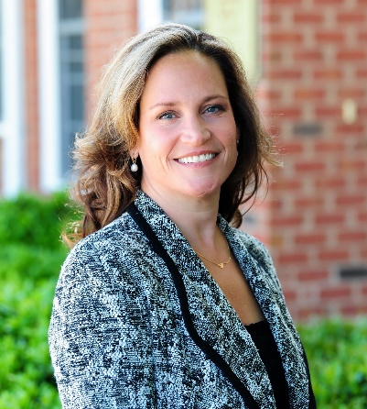
Questions? Feel free to reach out to us directly with any questions!
Joanne Marcus, MSW
President and CEO
jmarcus@trustCCT.org
Karen Dunivan Konvicka, J.D.
Director of Client Services and General Counsel
kkonvicka@trustCCT.org
(804) 740-6930
www.trustCCT.org

